Slide 1



Community of Practice 2
“Career Guidance & Life Skills at Schools, Universities, etc.”
July 24, 2019. 10AM to 12PM CEST
Facilitator Name: Happiness Uwase

Slide 2
Agenda for today
15 min
House Rules (microphone, mute/unmute, internal chat…)
CoP members introduction (first members joining the meeting)
Brainstorming- session on Challenges of our CoP2 topic with an online-tool – mind mapping
- this is a basic input for the future planning session in
Turin and
- The context for working on the existing and necessary
knowledge in the CoP (next step of today)
Introduction to the knowledge map topic (we collect further data from the CoP members during this session and present the knowledge map in Turin)
Info on the Turin event
45 min
30 min
20 min

Slide 3

Introduction to the brainstorming session
Brainstorming question: What are the main challenges/needs regarding “Career Guidance and Life Skills”?
Some “rules” for our discussion:
Defer judgement. You never know where a good idea is going to come from. For the moment there is no right or wrong…
Build on the ideas of others.
Stay focused on the topic.
One conversation at a time. Be short.
Go for quantity (“quick and dirty”). The filtering process (priority setting) will be made afterwards

Slide 4
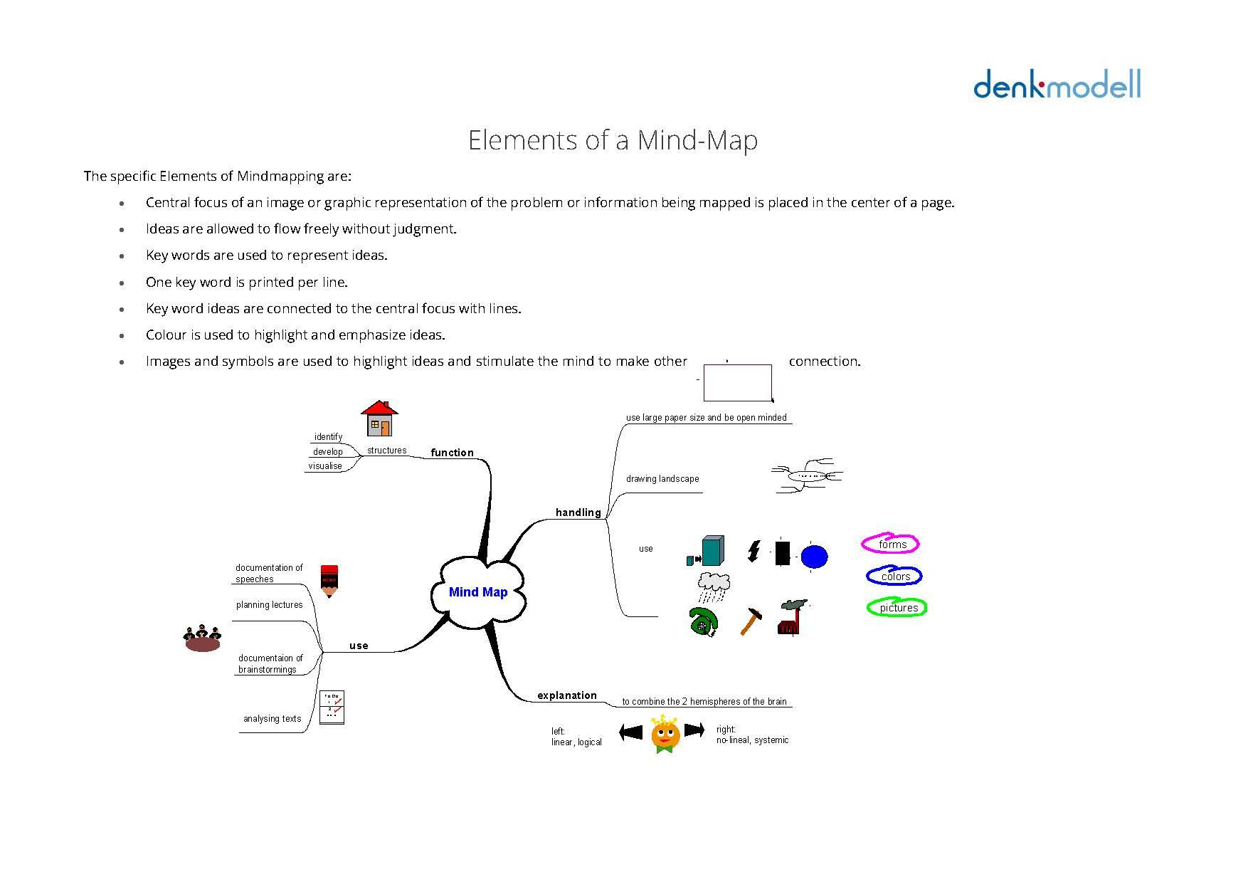
The tool we use: Mind Mapping
We will use a “Mind mapping tool” which helps us to visualize our analysis
Ideas are allowed to flow freely without judgment.
Keywords are used to represent ideas. One key word is written per line.
Keyword ideas are connected to the central focus with lines.

Slide 5
Let’s now use the mind mapping online…
I will moderate the discussion and Sharleen will help us to visualize.
We don’t at zero, but have started the analysis based on the documents we/you shared already…

Slide 6
Introduction to Knowledge Map
After having discussed what are the challenges of our CoP topic, …
we will now get to know more about knowledge maps and why they are useful for the CoP work.
we will also gather still some more information about the existing knowledge of the members in the CoP, so we as facilitators can better elaborate the draft for the CoP knowledge Map together with the GIZ focal point.

Slide 7
What is a knowledge Map?
Knowledge Maps visualize where a specific knowledge is located.
It also shows us how to find people with the most expertise. We can also call it an inventory of knowledge.
There are different types of knowledge maps. In general, we can distinguish maps which map
existing knowledge of a topic
identify the people who have the knowledge and how they relate among them
strategically knowledge needed in the future and help to analyse current knowledge gaps

Slide 8
Knowledge Maps in the CoP Work
During networking in the CoPs, we will map all three aspects. That is, we will ask:
Who in our CoP has special knowledge about “….”(CoP topic )
What knowledge is needed in the future to find solutions to identified challenges and problems?
Where to find this knowledge? Do we have the necessary knowledge in the CoP or do we need to look elsewhere ?

Slide 9
Definition of Knowledge Management
Knowledge Management is the process of creating, sharing, using and managing the knowledge and information in order to create new value in a strategic way within a defined and structured context (an organization, business, institution, thematic network or within a sector).

Slide 10
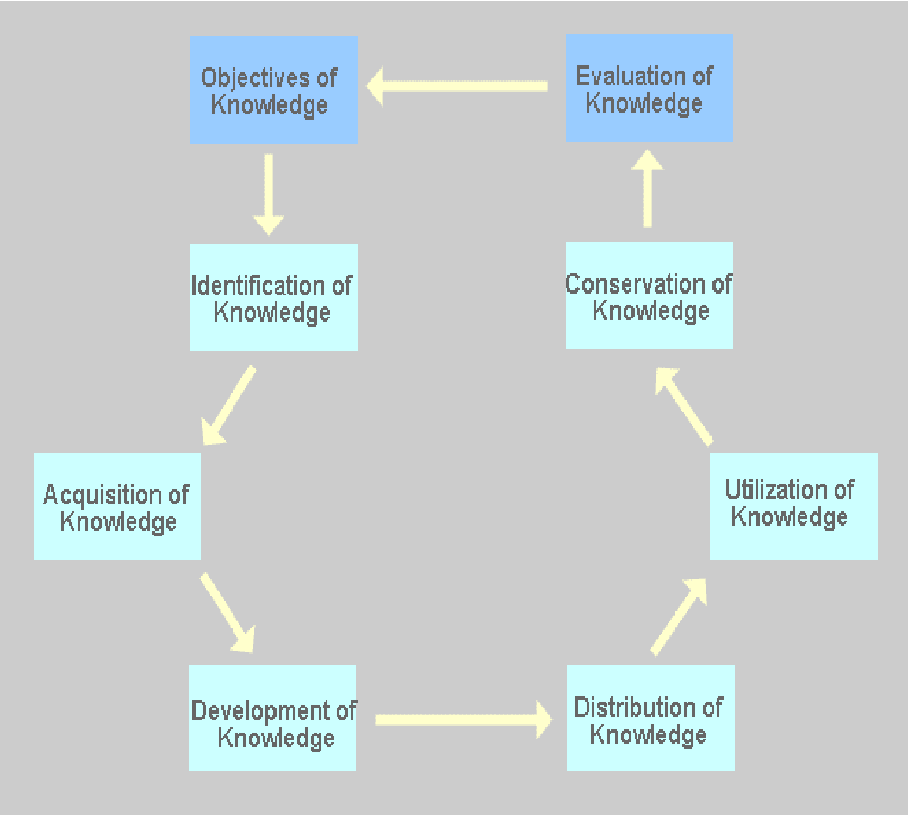
Knowledge Maps as part of a knowledge Management system
The cycle of knowledge management developed by the researchers Probst, Raub and Rombard as a pragmatic model of the process of knowledge management just fits fine this definition.
The model consists of 8 elements forming together a complex system, describing the sequences related to the knowledge cycle.
Knowledge MAPS help especially in the first steps of the knowledge cycle to identify existing knowledge.
Strategy

Slide 11
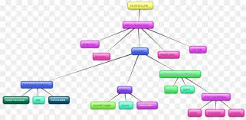
What are the sources for the knowledge Map of our CoP?
CoP members profiles
(with their described competencies)
The ILO Survey
Information
Information
Information
Further questions to CoP members on their specialties

Slide 12
Knowledge Map elaboration steps
The facilitator and the GIZ focal points have collected Knowledge Data from the sources (Members Profiles & ILO survey)
In this meeting CoP meeting, further knowledge questions are discussed and information gathered on the existing knowledge in the CoP
The facilitator of the CoP with the help of the GIZ focal point then develop a draft of the CoP knowledge Map
During the CoP Kick-off in Torino, the knowledge map is finalized and related to the situation analysis and the CoP planning. Finally, also the knowledge gap will be addressed (what do we do not know?)
What do we already know within our CoP ?
Which knowledge can we share?
What is the knowledge gap within our CoP ? What knowledge is missing?

Slide 13
Further Knowledge Questions for our data collection now
Insert Knowledge Questions – provided by focal points
What is your most important experience in the field of career guidance and life skills that you can share with the group? What role did you play in it and what expertise did you take from it ?
What are the 2 main competencies that would need to be developed in your country in order to improve career guidance and life skills – services in schools and universities?
Who has been involved in a policy development process? In which context and on what level ? What was your role in it?

Slide 14
Last topic for today – the Turin agenda
1st-2nd day of Turin event – 8.30am to 5.30pm
Opening session: PES and labour market policies: Overview and international instruments
4 groups / 6 (*90-minutes) sessions per group:
    1 - LM information systems : CoP 1 EN/CdP 1 FR
    2 – Managing effective Job Centres and tailoring employment services: CoP 3 EN/CdP 7 FR
    3 – Employability and career guidance: CoP 2 EN/CdP 2 FR/CdP 4 FR
    4 – Building partnerships and dialogue at the local level: CoP 5 EN/CoP 6 EN
  Sharing outcomes / market place

Slide 15
Last topic for today – the Turin agenda
3rd day of Turin event – 9am to 5.30pm
Objectives for the CoP Kick-off –meeting:
CoP members
get acquainted personally
define together the purpose definition of their CoP
elaborate together their CoP action plan, based on the brainstorming analysis
Finalize their knowledge map, identifying also knowledge gaps
Define next online-meeting date

Slide 16
Last topic for today – the Turin agenda
  Welcome/check-in / Introduction objectives & agenda
  Presentation of Knowledge Map and adjustment
  Recalling (online) brainstorming results (analysis) and defining priorities/intervention areas for the CoP work – based on defined criteria
  Purpose-Session (development of the purpose of the CoP)
  Action Planning (group work)
  Update of the knowledge Map: Which necessary knowledge do we have to “acquire”? By which means (expert input, training, self study, exchange with others…)
  Wrap up / next steps, closing, feedback of the day

Slide 17
Any other questions?

Slide 18
Check - out
Please formulate 1 sentence or even a word /person: “When I think of Turin: what is the thing I am looking forward to the most?”

Slide 19
Thank you !
Bye bye – we see each other in Turin !

